Slide 1
Cyber Law & Crime

Slide 2
“The modern thief can steal more with a computer than with a gun. Tomorrow’s terrorist may be able to do more damage with a keyboard than with a bomb.”
National Research council, U S A “Computers at Risk”.1991

Slide 3
Need of Cyber Law
Cyber Crime
Introduction of Cyber law
IT Act-2000
IT Act Amendment-2008
World & Cyber Law
Importance of Cyber Law in Present Era

Slide 4
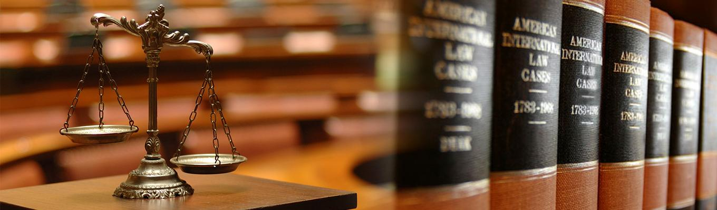
Need of Cyber Law

Slide 5
Need of Cyber Law
Internet has dramatically changed the way we think, the way we govern, the way we do commerce and the way we perceive ourselves.
Information technology is encompassing all walks of life all over the world.
The Internet is without a doubt one of the best resources available to us.
Unfortunately it's also extremely dangerous if we aren't aware of who and what lurks behind the scenes.
People have access to a virtually limitless world so we should be aware of the risks.
Cyberspace is open to participation by all.
“IT” has brought Transition from paper to paperless world.
The law of real world cannot be interpreted in the light of emerging cyberspace to include all aspects relating to different activities in cyberspace.
Internet requires an enabling and supportive legal infrastructure in tune with the times

Slide 6
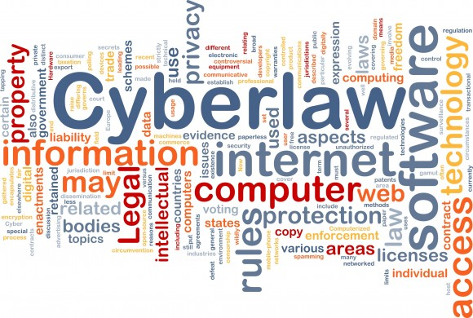
Cyber Law Deals With
Cyber Crimes
Electronic or Digital Signatures
Intellectual property
Data protection and Privacy

Slide 7
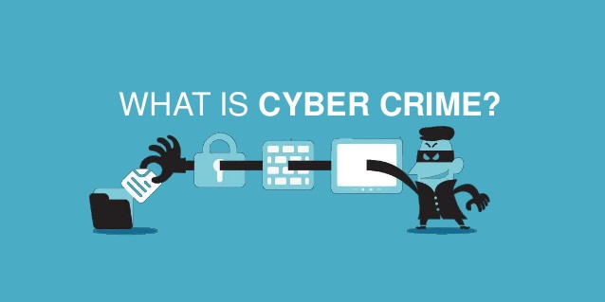

Slide 8
Cyber Crime ?
Any crime with the help of computer and telecommunication technology.
Any crime where either the computer is used as object or subject.
Or We can say that the computer is either a tool or target or both”.

Slide 9
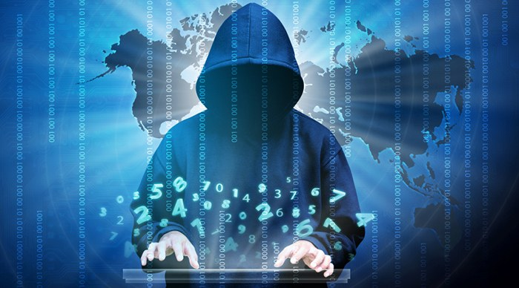
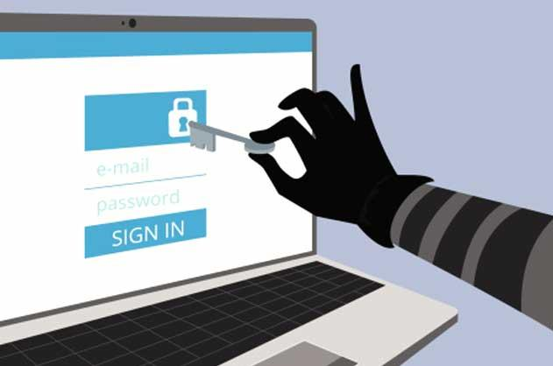

Types of Cyber Crime ?

Slide 10
Types of Cyber Crime ?
Hacking
Denial of service attack
Virus dissemination
Software Piracy
Pornography
IRC Crimes
Credit Card Fraud
NET Extortion
Phishing
Spoofing
Cyber Stalking
Cyber Defamation
Threatening
Salami Attack

Slide 11
These types of crimes may be
Hacking : Fraud and Financial crimes and thefts, cyber extortion
copyright infringement
Child pornography and child bullying.
harassment and crime against women
other cross-border crimes, cyber terrorism,
Activity crossing international borders and involving the interests of at least one nation state is sometimes referred to as cyberwarfare.

Slide 12
Types of Cyber Crime
Cybercrimes against persons.
Cybercrimes against property.
Cybercrimes against government.

Slide 13
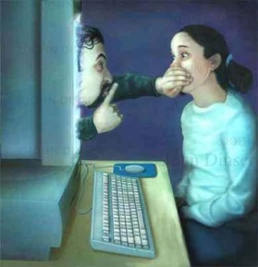


AGAINST A PERSON

Slide 14
AGAINST A PERSON
Cyber stalking
Impersonation
Loss of Privacy
Transmission of Obscene Material(Child pornography) and child bullying.
Harassment with the use of computer.

Slide 15
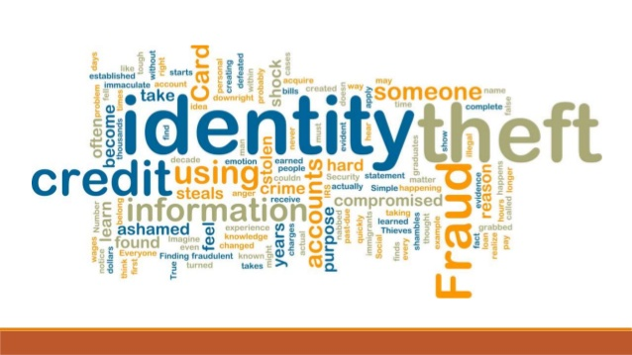

Against Property

Slide 16
Against Property
Copyright
Unauthorized computer trespassing
Computer vandalism
Transmission of harmful programmes
Siphoning of funds from financial institutions.
Stealing secret information and data.

Slide 17
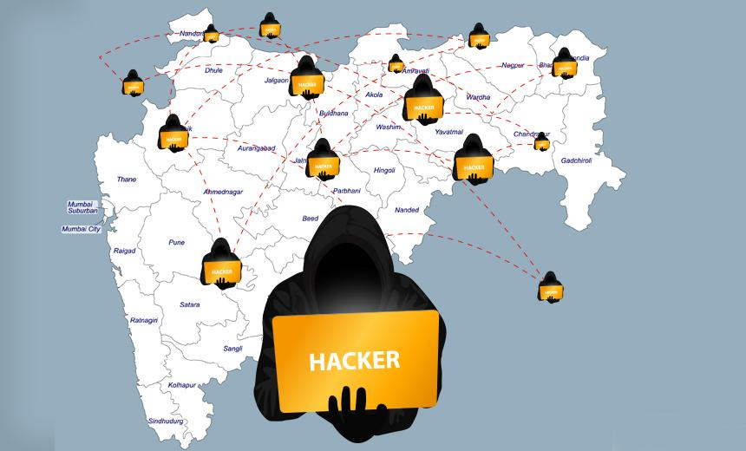

Against Government

Slide 18
Against Government
Hacking of Government websites
Cyber Extortion
Cyber terrorism
Computer Viruses

Slide 19

INDIA 5TH AMONG CYBER CRIME AFFECTED COUNTRIES
India 5th in world after US, China, Japan and UAE.
Andhra State tops in India. 349 of the total 1,791 cyber crime cases registered last year 2011 were reported from the state.
Maharashtra followed with 306 cases.
Pune is third in instances of cyber crime: National Crime Records Bureau reports.

Slide 20
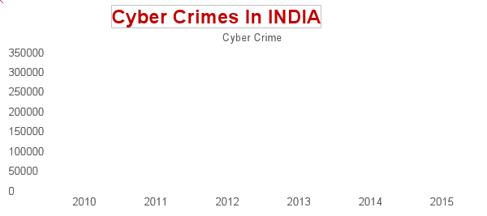
Statistics of Cyber Crimes
Year | 2010 | 2011 | 2012 | 2013 | 2014 | 2015
Cyber Crimes | 1322 | 13,301 | 22060 | 71,780 | 1,49,254 | 3,00,000

Slide 21

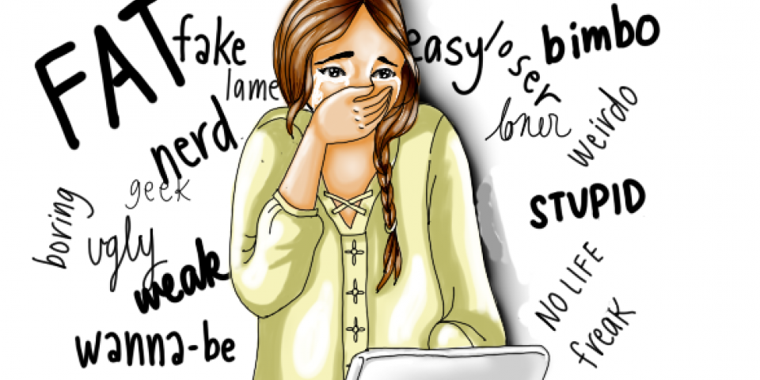
Cyber Bullying

Slide 22
Cyber Bullying
Cyberbullying is bullying that takes place using electronic technology. When people get bullied on the internet and its hurts their feelings.
Electronic technology includes devices and equipment such as
cell phones,
computers, and tablets
as well as communication tools including social media sites, text messages, chat, and websites.
Example of Cyber Bullying
Text messages or emails,
Rumors sent by email or posted on social networking sites,
Embarrassing pictures, videos, websites, or fake profiles.

Slide 23

Why do children cyberbully?
Anger
Frustration
Revenge
Entertainment
To get Laugh or Reactions
Power Hungry
Because all motives for bullying are different so are the solutions and responses.

Slide 24

Effects of Cyber Bullying
Kids who are cyberbullied are more likely to:
Skip school to avoid bullies in school
Low self esteem.
Receive poor grades
Be unwilling to attend school
Loneliness
Use alcohol and drugs
Have more health problems

Slide 25
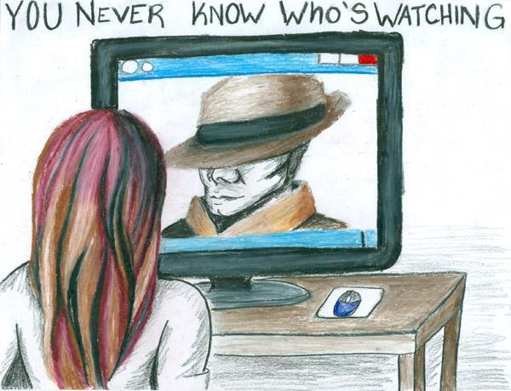
CyberStalking

Slide 26
Cyber Stalking
Cyberstalking is a new form of computer related crime occurring in our society.
It means when a person is followed or pursued online invading his/her privacy as his/her every move watched.
It is a form of harassment that can disrupt the life of the victim and leave him/her feeling very afraid and threatened.
Cyberstalking usually occurs with women, who are stalked or harassed by men, or with children who are stalked by adult predators or pedophiles.
Cyber Stalker need not have to leave their home to find, or harass their targets and has no fear of physically violence since they believe that they cannot be physically touched in cyberspace.
They use Internet, e-mail and other electronic communication devices to stalk persons.

Slide 27
Cyber Stalking
The core areas where the stalking takes place are;
live chat rooms/flaming
e-mail,
discussion forums and
message boards.

Slide 28
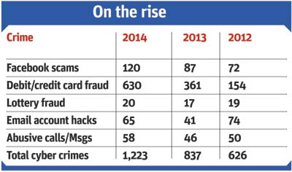
Area prone to cyber crime and
should be secured
Safe Surfing Practices
Browse Security and issues
Email Hacking and security
Downloading Software’s/Application
Social networking sites
Cyber Stalking
Cyber Bullying
Security features for popular Apps like Facebook, YouTube etc.

Slide 29
Area prone to cyber crime and should be secured
Mobile Social Media
Smartphones and securities
Popular Apps like whatsapp,Viber,Instagram etc
Threats and Securities
E-commerce Securities
Online shopping and banking
Debit/credit cards threats and securities
Frauds and securities

Slide 30
What a school should Do?
Create Cyber Crime Reporting Cells in school (Cyber Congress Cell.)
Child Helpline: Create a HOTLINE with a team counselors/Cyber Experts in your region. May team up with Mobile Service Provider to provide a Toll Free Number where a student/victim can records his message on voice box and this can be altered to Expert Team to records a reply for the student.
Create a WEBPAGE with complaint form/Email Address which can be later addressed by the Team. To have one Complaint Box for internet/ Mobile related problems.
Ensure Online Safety
Take help from NGOs, Local Cyber Police.

Slide 31
What a school should Do?
Cyber Journal/Online or on paper may be published by the region on Regular Basis.
Emphasis on Positive Use Of Internet/Mobile based on creative projects for students.
Awareness WORKSHOPS for students and parents at regular intervals.
Cyber congress : To give one day in a month on cyber Safety/Cyber Congress
Make all subject teachers be a part of the Cyber Safety Drive.
Train the teachers on Cyber Threats and Securities
Cyber Exhibitions should be organized by schools/regions

Slide 32
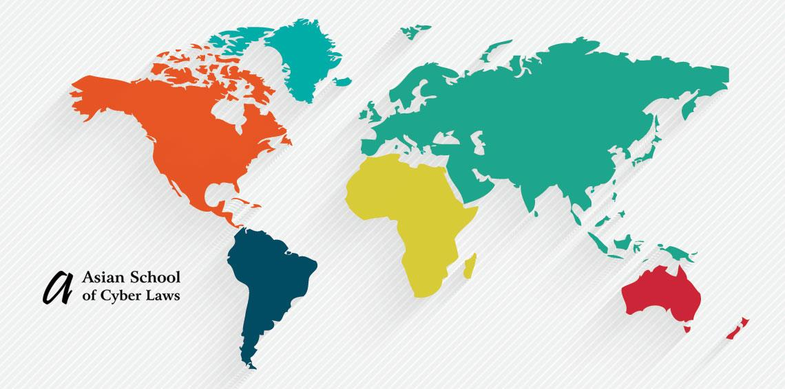

Cyber Congress

Slide 33
Cyber Congress
School or Group of Schools in a region to appoint one dedicated CSO “Cyber
Security Officer” under which a Cyber Congress in each school will be
functional.
Team of Cyber Congress will consist of :
One/Two parents from Parents Association.
One/Two ICT Teachers/Counselors to be a part of the team
4-6 Students from Senior/Middle Section

Slide 34
Function of Cyber Congress
Spread and create awareness among students on regular intervals about Cyber
Safety- DO’s and DONT’s
Discuss issues and problems and to find solutions for the same.
Create events with school staff on regular interval on
Cyber safety theme like Essay Contest, Debate, Exhibition, Poster Competition, Drama skit etc.

Slide 35

Teacher’s role to Prevent Cyber Crime
Character Education is very important to prevent any type of crime in the society.
Personality development of students should be given preference in comparison to rote learning.
Students should be guided about the following points regarding the use of Internet
Don’t give out personal information in chatrooms, social websites, blogs etc.

Slide 36

Teacher’s role to Prevent Cyber Crime
Don’t’ tell anyone , even your best friends, your passwords.
If they receive any mean or threatening messages in the chatroom, text or email don’t ever respond.
If they receive any mean or threatening messages in the chatroom, text or email don’t ever respond. Don’t delete the message, save it and show to an adult- they might need the message to use as evidence against the person who sent it.

Slide 37

Teacher’s role to Prevent Cyber Crime
Don't suffer in silence. If they are being bullied then they should tell their parents. If they don't feel to talk to them then tell a teacher or an adult that you trust. You mustn't keep it to yourself because if you do, the bully has got exactly what they want.
They should be made aware about cyber bullying and that it is a punishable offence as per cyber law.

Slide 38
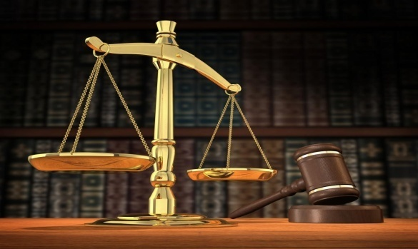
What does The Law Says
Cyber crime can involve criminal activities that are traditional in natures such as theft, fraud, forgery, defamation and mischief, all of which are subject to the Indian Penal Code. The abuse of computers has also given birth to a gamut of new age crimes that are addressed by the “Information Technology Act, 2000”.
Section 67, 67A, 67 B, 67 C and 69 deals with child abuse, pornography, MMS etc. and it is essential that person handling child bullying and other related issues is aware of these sections

Slide 39
IT ACT-2000
The Information Technology Act, 2000 (IT Act), came into force on 17 October 2000.
The primary purpose of the Act is to provide legal recognition to electronic commerce and to facilitate filing of electronic records with the Government.
Information Technology Act 2000 consisted of 94 sections segregated into 13 chapters.

Slide 40

Cybercrime provision under IT Act, 2000
Cyber crime can involve criminal activities that are traditional in natures such as theft, fraud, forgery, defamation and mischief, all of which are subject to the Indian Penal Code. The abuse of computers has also given birth to a gamut of new age crimes that are addressed by the “Information Technology Act, 2000”.
India is 12th nation in the world to adopt cyber laws
Section 67, 67A, 67 B, 67 C and 69 deals with child abuse, pornography, MMS etc. and it is essential that person handling child bullying and other related issues is aware of these sections

Slide 41
IT ACT-2000 : OBJECTIVES
To provide legal recognition for transactions
To facilitate electronic filing of documents with the Government agencies.
Aims to provide the legal framework to all electronic records.

Slide 42
IT ACT-2000
Important Cyber Law
Provisions in India
Offence Section under IT Act
Tampering with Computer source documents
(with out the permission of in charge) Sec.43
Hacking with Computer systems, Data alteration Sec.66
Publishing obscene information Sec.67
Un-authorized access to protected system Sec.70
Breach of Confidentiality and Privacy Sec.72
Publishing false digital signature certificates Sec.73
Notes:
NOTE: Sec.78 of I.T. Act empowers Deputy Superintendent Of Police to investigate cases falling under this Act

Slide 43
IT ACT-2000
Crimes under Indian Penal Code and Special Laws
Offence Sections
Sending threatening & Defamatory messages by email Sec 503 & 499 IPC
Forgery of electronic records Sec 463 IPC
Bogus websites, cyber frauds Sec 420 IPC
Email spoofing & Abuse Sec 463 & 500 IPC
Web-Jacking Sec 383 IPC
Online sale of Drugs NDPS Act
Online sale of Arms Arms Act
Notes:
x

Slide 44
SECTION 43
If any person uses a computer or system network without permission of the owner or any other person who is incharge &
Access, download, Copy any data from such computer
Introduces Computer Virus into any computer.
Damages any computer network or computer.

Slide 45
SECTION 43A
Changes Account Settings.
Punishment
He shall be liable to pay damages by the way of
compensation not exceeding 1 Crore to affected person.

Slide 46
SECTION 66
Hacking with Computer System
Information residing in a computer resources must be either:
Destroyed
Deleted
Altered
Diminished in value or utility
Affected Injuriously
Punishment
3 yrs. Or Fine up to 2 lakh.

Slide 47
SECTION 67 . PORNOGRAPHY
Publication or transmitted in the electronic form any material which contains sexually explicit acts or conduct.
Punishment
1st conviction with 2 to 5 years of imprisonment and fine of 1 lakh rupees.
2nd or subsequent conviction with the imprisonment up to 7-10 years and also with fine which may extend to 10 lakh rupees.

Slide 48
SOME OTHER SECTIONS
Section 65 : Tampering with computer source document.
Punishments
Offences are punishable with imprisonment up to 3 yrs. And/or fine up to Rs. 2 lakh.
Section 69: Interception, monitoring of any information regarding the integrity, Security or defense of India, friendly relations with foreign countries.
Punishment
2 lakh and /or jail not extending 5 yrs

Slide 49
SOME OTHER SECTIONS
Section 502A: Publishing, Transmitting images of the private area of a person without his or her consent.
Punishment : 2yrs./2 lakh.
Section 419A: Cheating by any communication device or computer resource
Punishment : 5yrs.
Section 417A: Identity Theft
Punishment: 2yrs.
Section 72: Violation of the privacy policy
Punishment: Fine up to 5 lakh jail not extending 2 yrs.

Slide 50
IT ACT AMENDMENT-2008
The Information Technology Amendment Act, 2008 (IT Act 2008) has been passed by the parliament on 23rd December 2008.
It received the assent of President of India on 5th February, 2009.
The IT Act 2008 has been notified on October 27, 2009.

Slide 51
IT ACT AMENDMENT-2008
ITA-2008, is a new version of IT Act 2000.
Provides additional focus on Information Security.
Added several new sections on offences including Cyber Terrorism and Data Protection.

Slide 52
WORLD & CYBER LAWS
The Great firewall of China monitors every movement in cyber space and protect to publish any offensive content.
China have a hold on every content which is harmful of dangerous for the government of China.
Brazil is considered world’s biggest airport for Hackers.
Iran is also a dangerous country for the Netizens. He also have a Crime Police unit for crime in Cyber Space.

Slide 53
IMPORTANCE OF CYBER LAW
We are living in highly digitalized world.
All companies depend upon their computer networks and keep their valuable data in electronic form.
Government forms including income tax returns, company law forms etc are now filled in electronic form.
Consumers are increasingly using credit cards for shopping.

Slide 54
Importance of Cyber Law
Most people are using email, cell phones and SMS messages for communication.
Even in "non-cyber crime" cases, important evidence is found in computers /cell phones e.g. in cases of divorce, murder, kidnapping, organized crime, terrorist operations, counterfeit currency etc.
Since it touches all the aspects of transactions and activities on and concerning the Internet, the World Wide Web and Cyberspace therefore Cyber Law is extremely important.

Slide 55
BrainStorming

Slide 56
REFERENCES
www.cyberlawclinic.org/
DAV CMC/CAE/RD
http://cyberlawsindia.net/
http://mit.gov.in/hindi/node/1435#
http://www.samvadsetu.com/?p=325
http://slideshare.net
http://www.indiancybersecurity.com/dwn_cyber_law.html
http://www.ahyep.com
www.leawo.com/free-powerpoint-templates/
http:// www.ncrb.nic.in

